Slide 1
Proof of Concept Of BookMyCon

Slide 2
Agenda
1. Background
Work Space Management, the future of HOW WE WORK!
Solution to Setup a Booking System for Meeting rooms.
Collaboration with video conferencing apps that allows you to view and present in real time.-*
Integration With Calendar, so you can stay on top of your schedule.
GDPR compatible Database Migration.
2. Work Flow
Requirement Gathering
Planning Phase
Tools used
Work Flow
Future Planned Enhancement

Slide 3
Requirement Gathering
Future of workspace is scheduling software and suite of integrations help ensure your people have everything they need to plan their day, to collaborate better, and to be more productive.
Click to Open doc:-

Slide 4
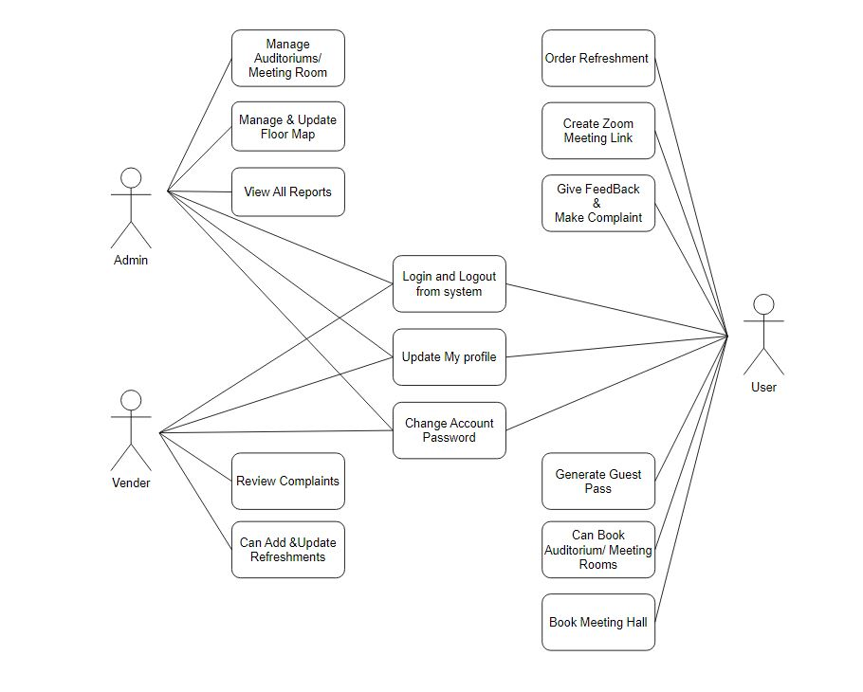
II. Planning phase
Use Case Diagram

Slide 5
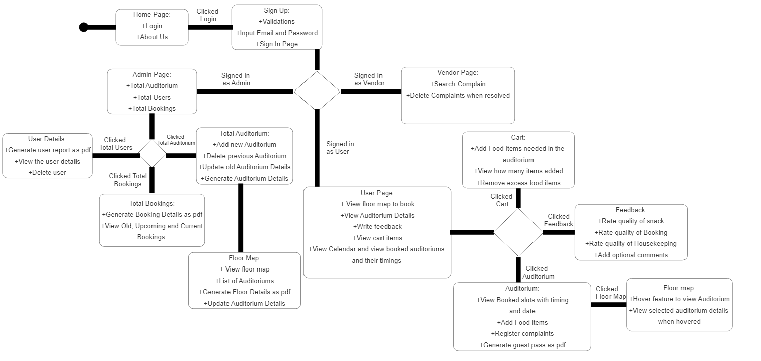
UML Diagram

Slide 6
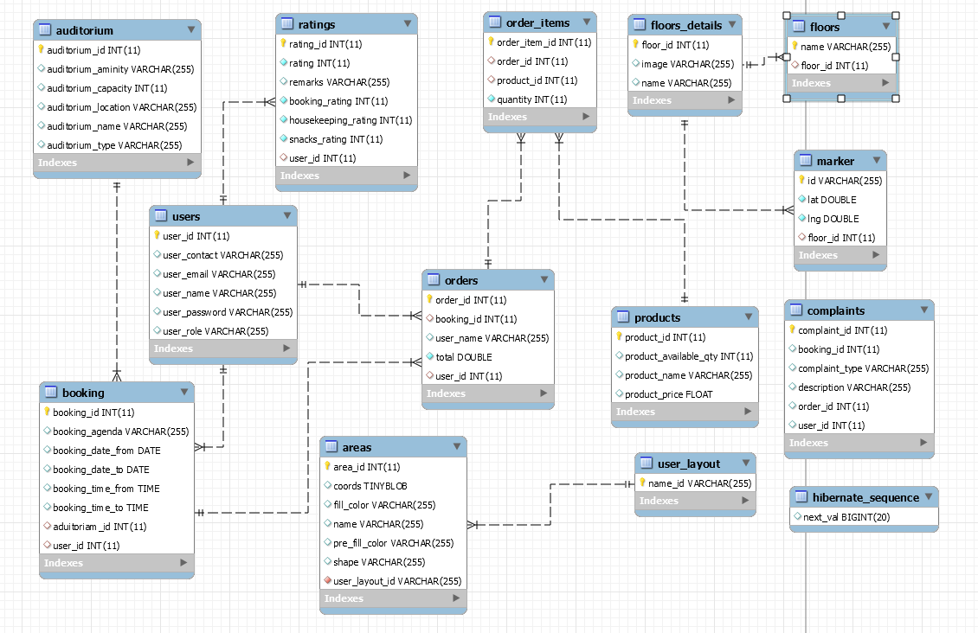
ER Diagram

Slide 7
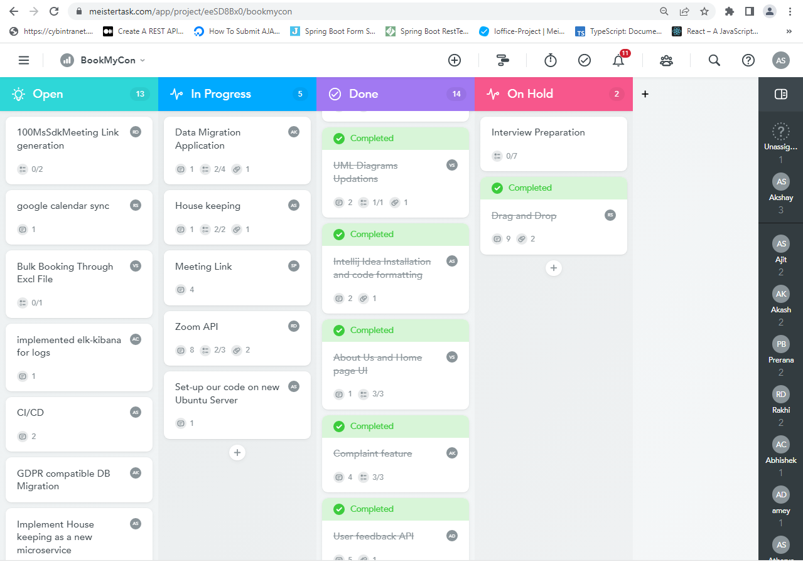
Approaches
Meister Task – Agile Mythology

Slide 8
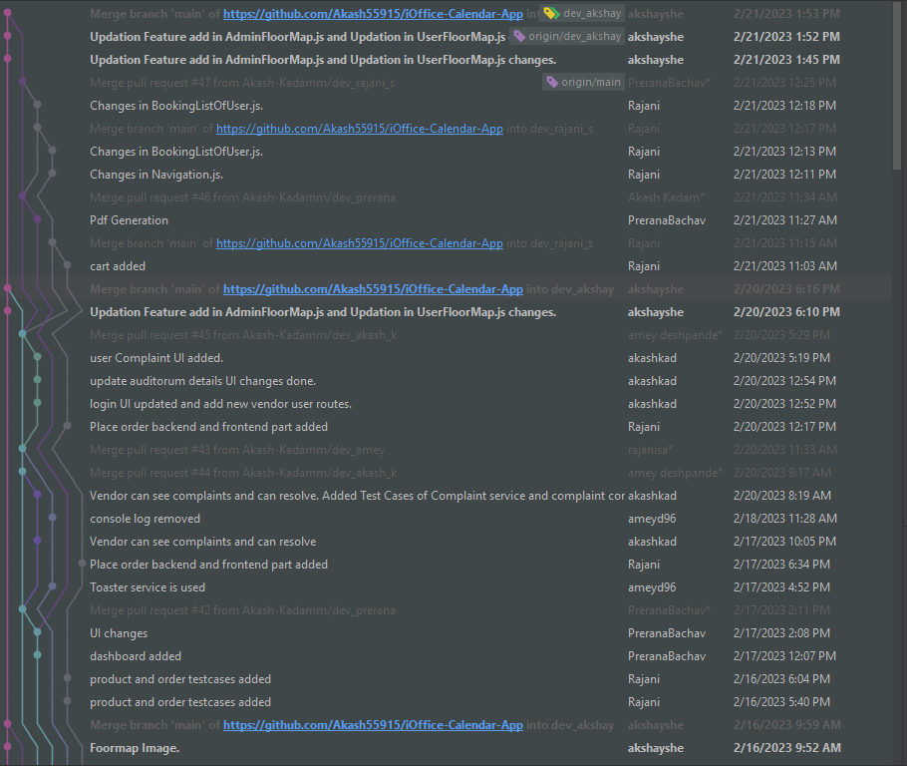
III.Tools And Technologies
Java (Version 11)
React js
Spring Boot Rest Api
Mysql Database
Kafka
Postgresql Database
Junit 4,5
Github
Kibana
Jenkins
Docker
Redis
Future Planned enhancement
Migrate to java 19
Migrate to spring boot 3.3
Use NoSQL
CICD
Use Redis cache
Use CDN to store Floor Map

Slide 9
IV. Working Flow
1. Admin
2. User

Slide 10
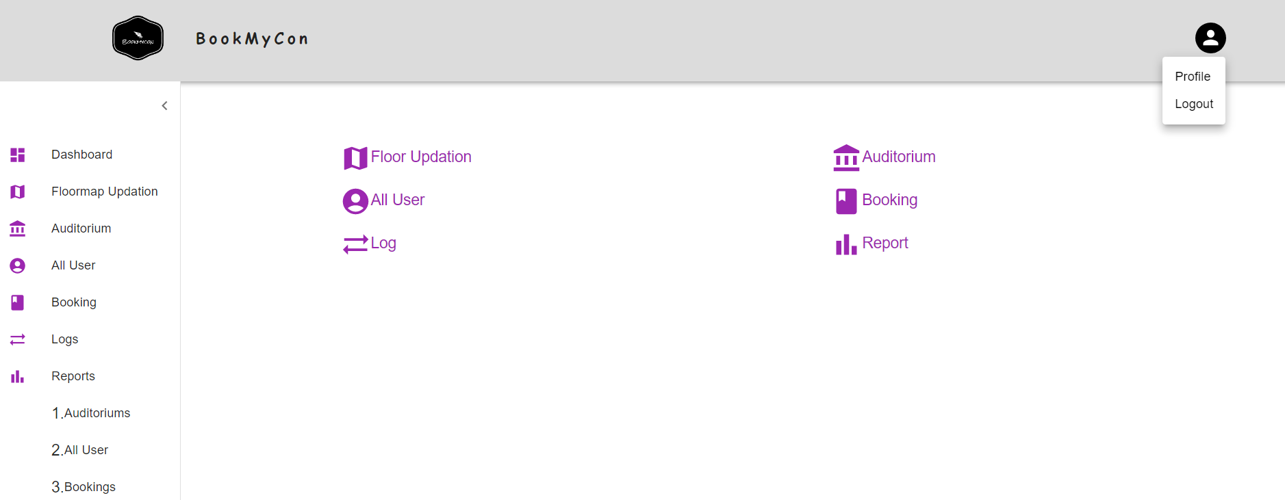
Admin
New Dashboard

Slide 11
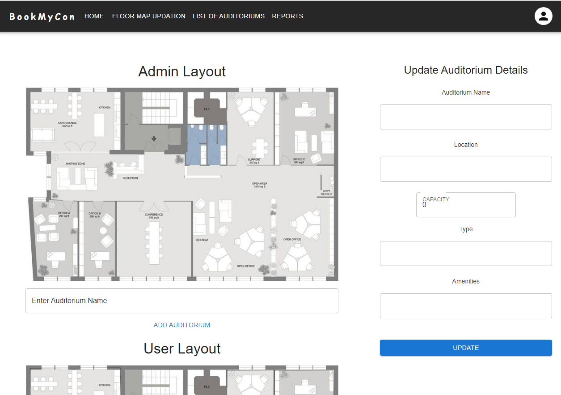
Old Floor Map Interaction

Slide 12
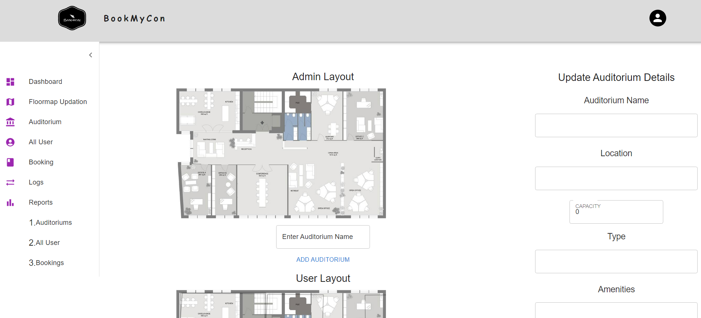
New Floor Map Interaction

Slide 13
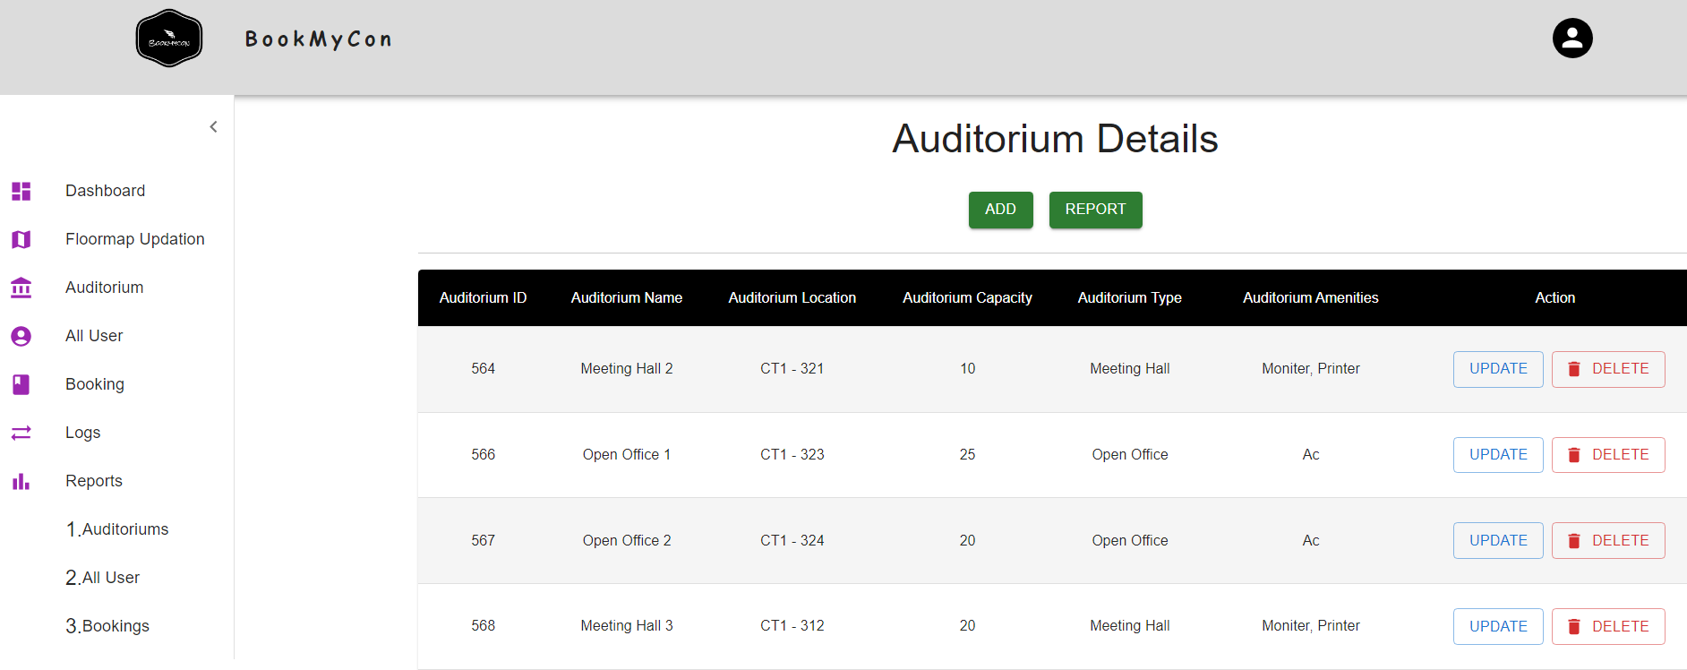
List Of Auditoriums

Slide 14
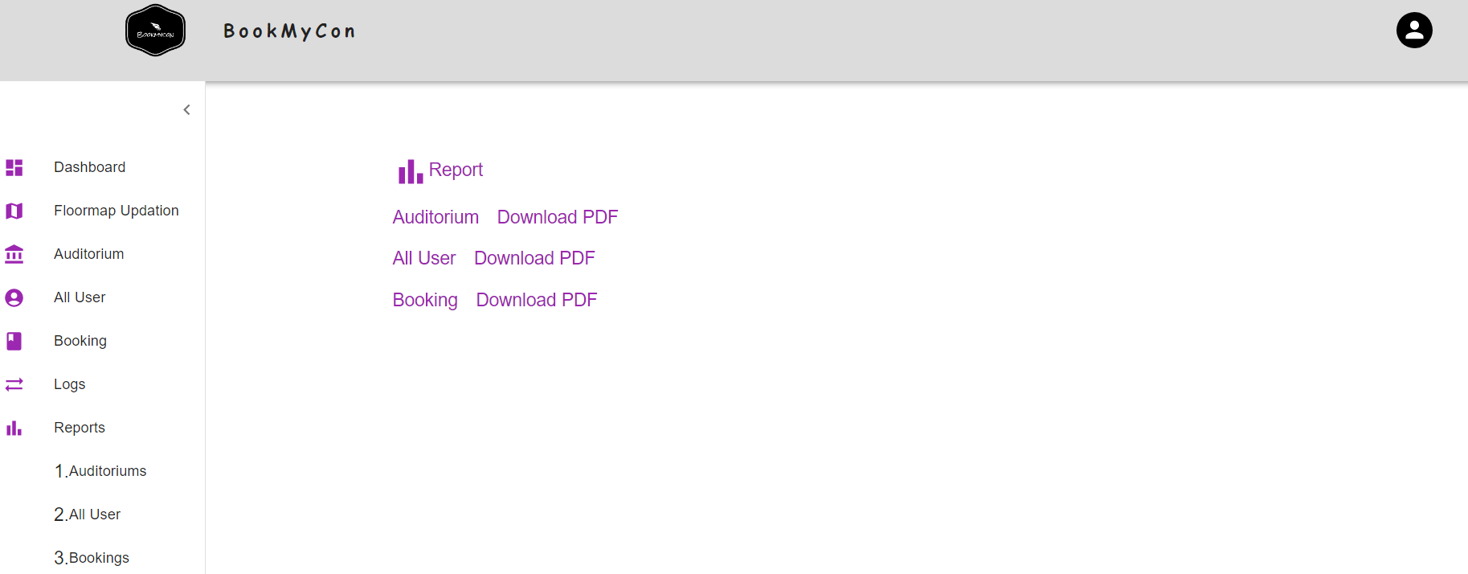
Report Part

Slide 15
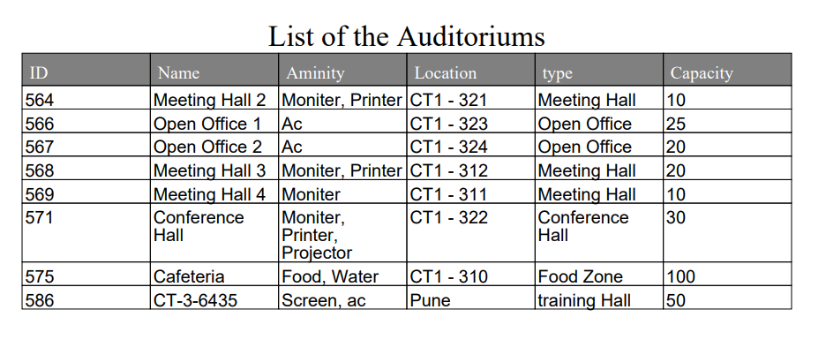
New Report Generation

Slide 16
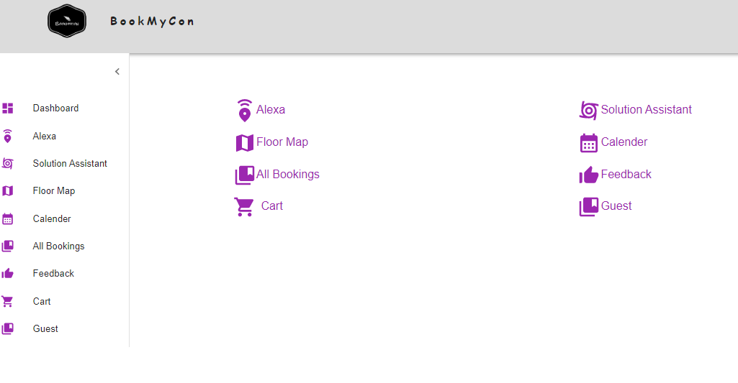
User
New Dashboard

Slide 17
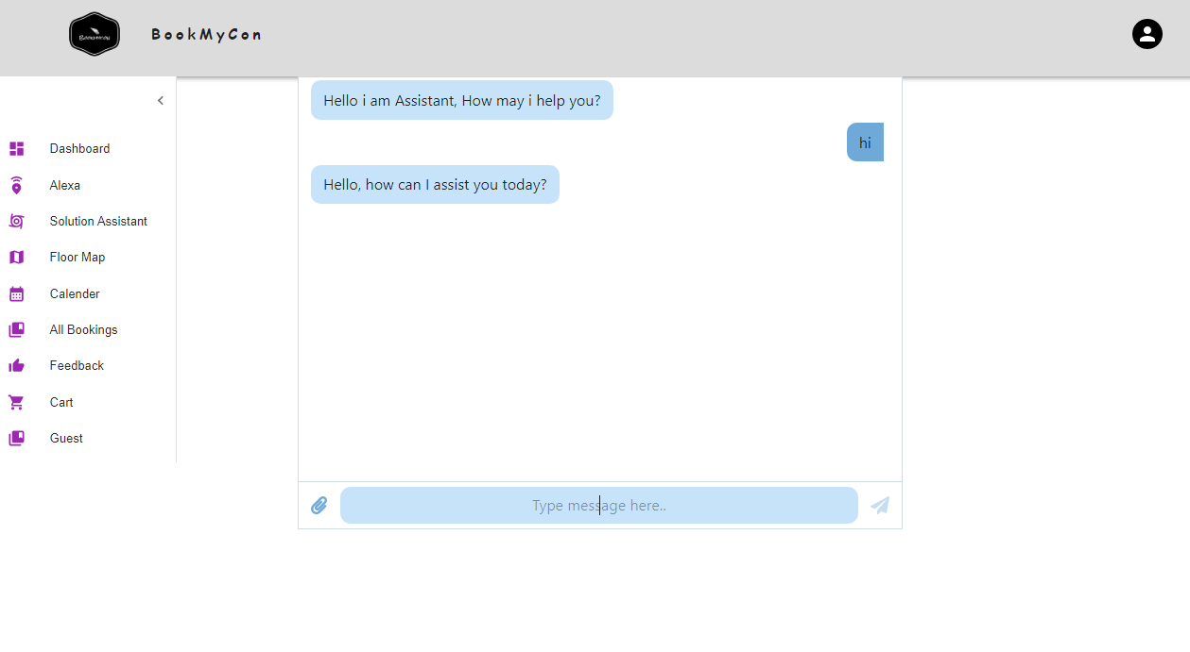
Solution Assistant

Slide 18
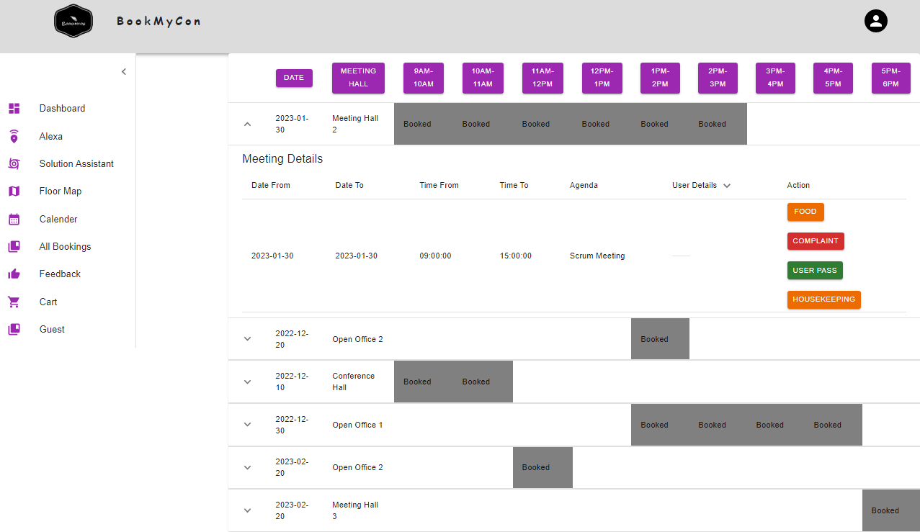
View

Slide 19
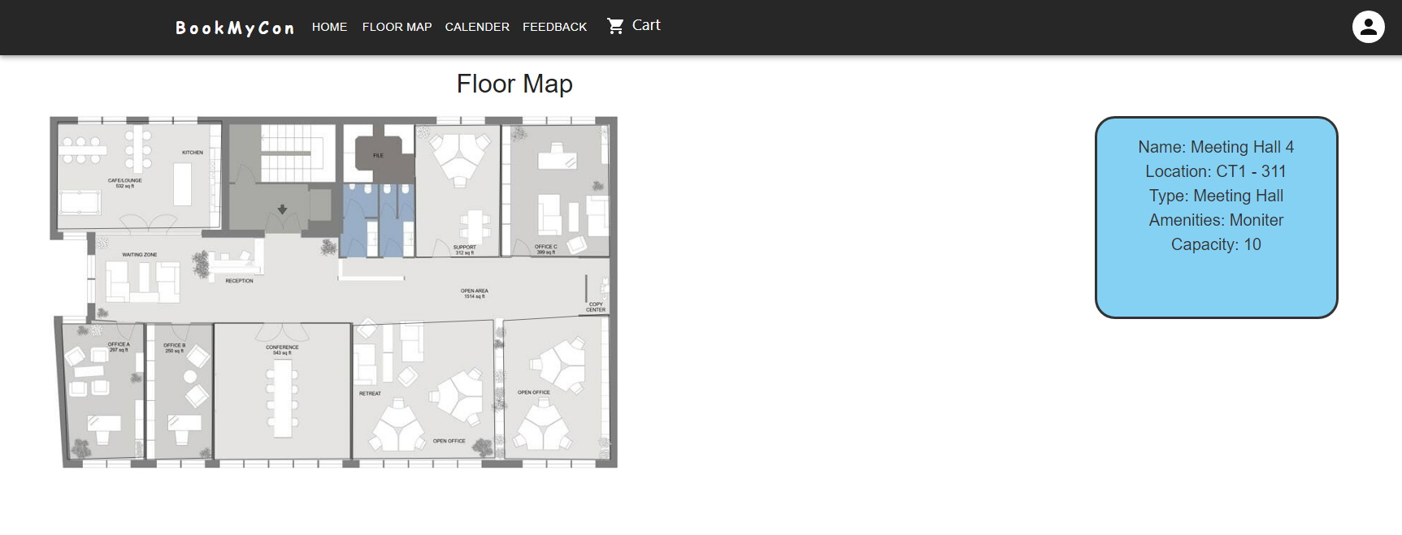
IV. Working Flow
Floor Map

Slide 20
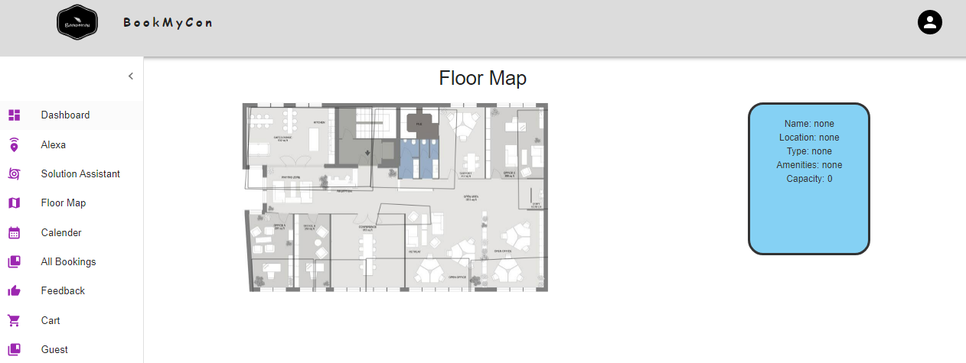
New Floor Map

Slide 21
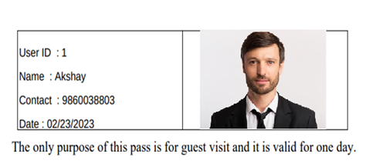
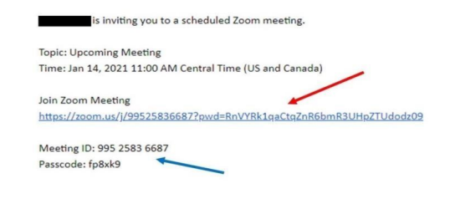
Guest Pass and Zoom link
Guest Pass :-User can generate Guest Pass
Zoom Link:-On Booking User can create zoom link
Report generation in pdf form

Slide 22
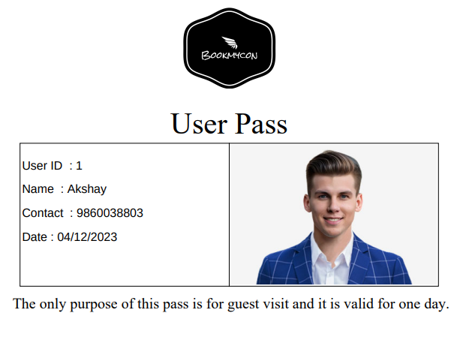
New Guest Pass
Guest Pass :-User can generate Guest Pass

Slide 23
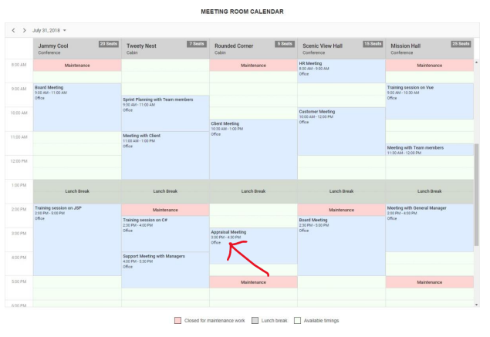
Calendar

Slide 24
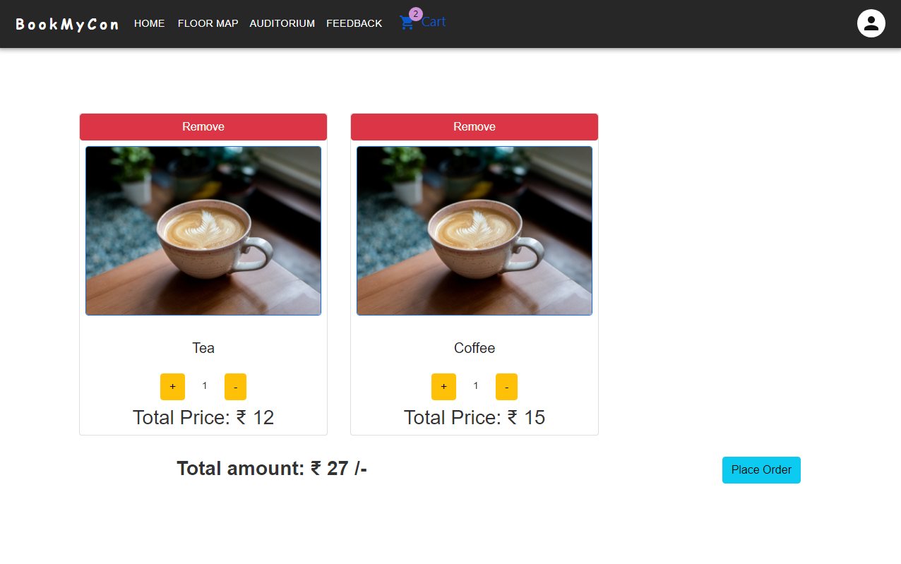
Refreshments
Future enhancement
Zoom and Teams integration
House Keeping

Slide 25
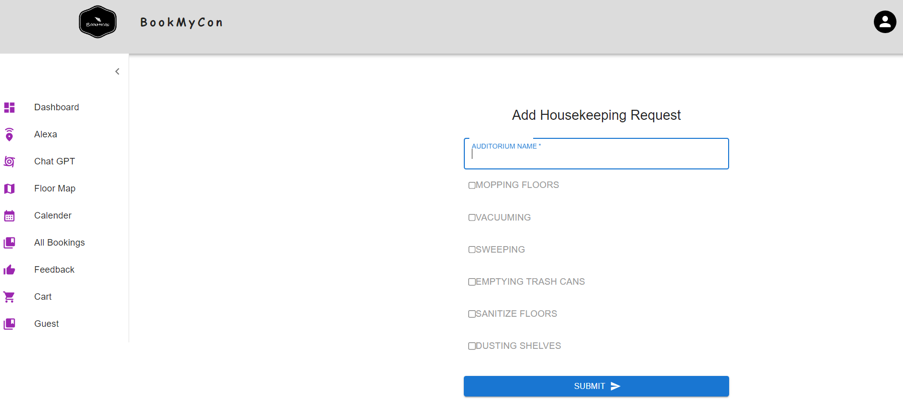
House Keeping

Slide 26
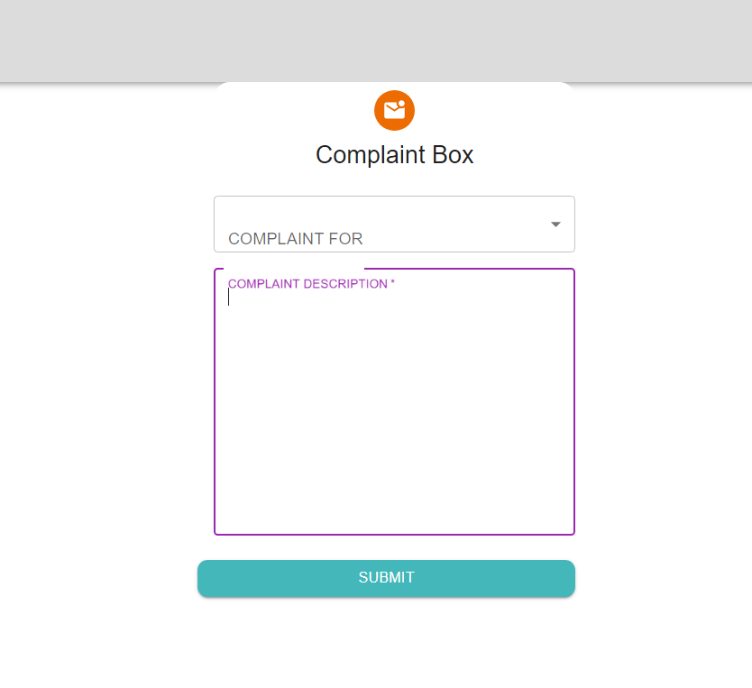
Complaint Part

Slide 27
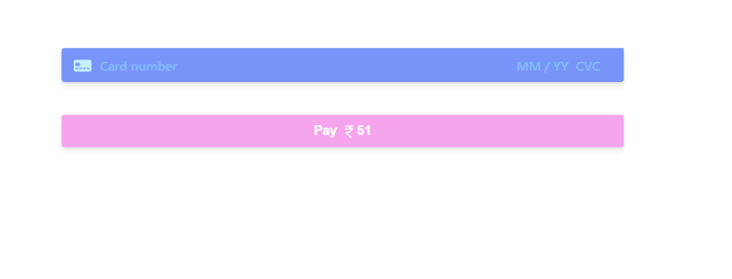
Payment

Slide 28
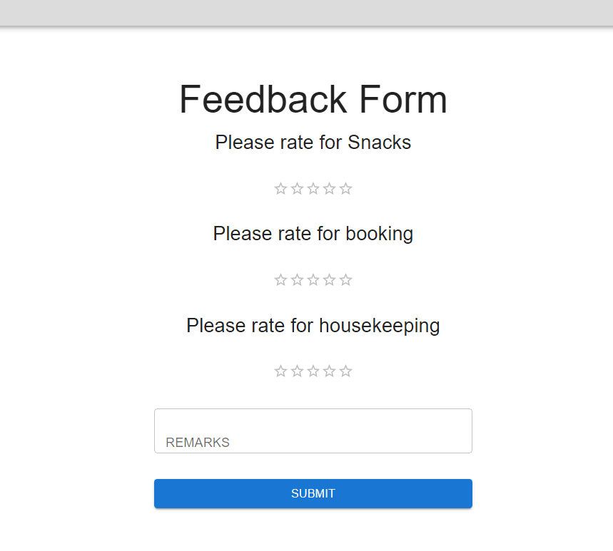
Feedback

Slide 29




Alexa :
Book Conference
BookMyCon Server Processing
Alexa, Book 6811 For Me
Possible Options
If 6811 is not booked, It will get Booked
If 6811 is booked, Shall I provide you free Slots?
Yes
Free slots from 2pm to 6pm, Shall I Book?
It will work accordingly for booking, cancellation, reschedule.
Yes
Ok, It is booked

Slide 30
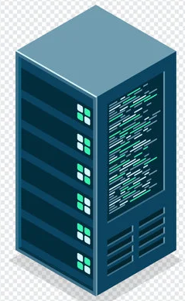

Guest Pass Generation
Alexa, Debasis Ray from cybage is utilizing our BookMyCon facility, Please generate Guest Pass for him
Check local system
BookMyCon Server is Processing
If Data Found
If Data Not Found
Generating PDF of Guest Pass
I am not able to find anything.
Send Guest Pass To Debasis Ray via Email.
Sending Guest Pass To Debasis Ray via Email.

Slide 31
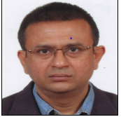
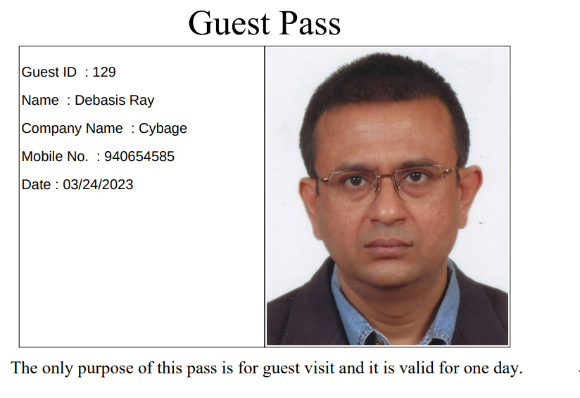
API call to ChatGPT
If Data Not Found
Give me photograph of from cybage
Give Me email id of
Guest Pass Generated
debasisr@cybage.com

Slide 32
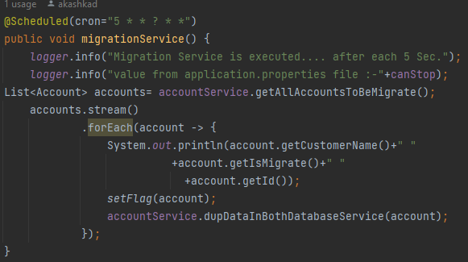
Database Migration
We solve this problem with two different solutions
Database Migration with Scheduler
Database Migration with Kafka
1. Database Migration with Scheduler
Declared two data source properties in application.properties
Configure two data source classes for mysql database and postgresql database.
Database migration service with @scheduled annotation for older data migration.
Pass the cron expression to database migration service.
For new upcoming data create end points to store data in both database.

Slide 33
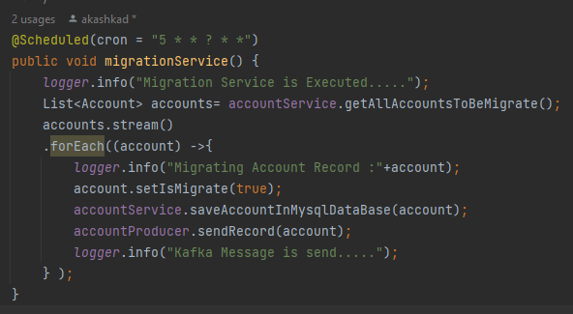
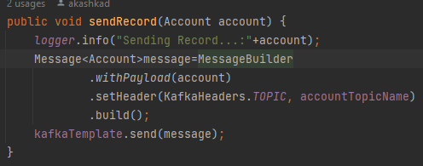
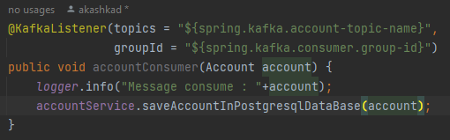
2. Database Migration with Kafka
Declared two data source properties and kafka configuration in application.properties
Configure two data source classes for mysql database and postgresql database.
Create kafka topic and use kafka template.
Create kafka producer and kafka consumer which is responsible to produce and consume kafka events.
Database migration service with @scheduled annotation for older data migration.
Pass the cron expression to database migration service.
For new upcoming data create end points to store data in both database.
Benefits:-
We done load test on both applications and we found that second solution is having higher performance.
Kafka stores data as well as do Asynchronous operations.

Slide 34
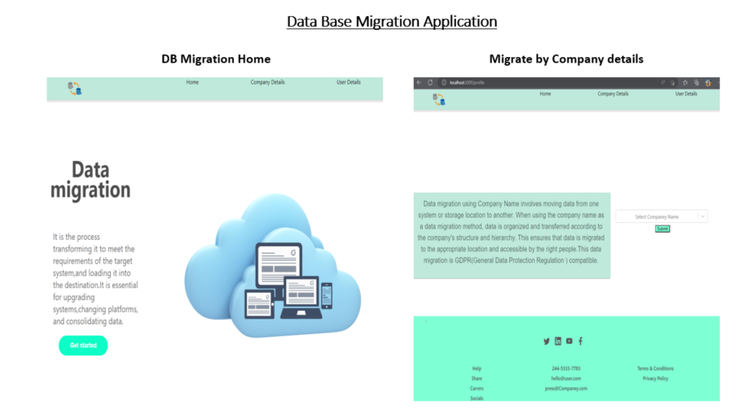

Slide 35
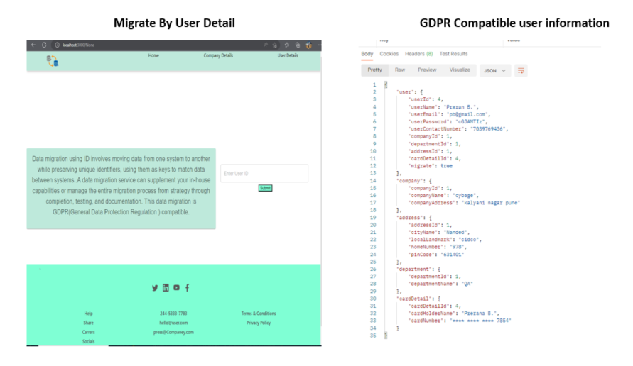

Slide 36
GDPR Compatible
User has right to access.
The right to data portability.
The right to be forgotten.
The right to modification.

Slide 37
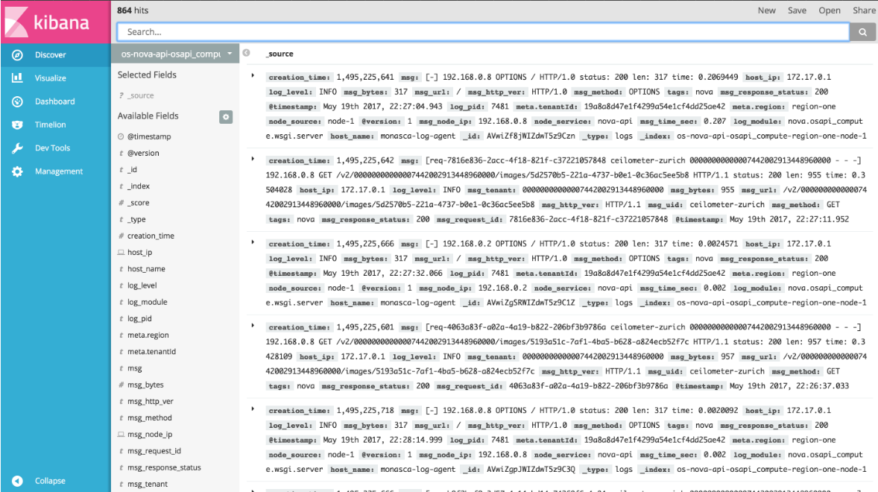
Kibana Logs
Kibana Logs is a great way to see what's going on in your application and to debug performance issues

Slide 38
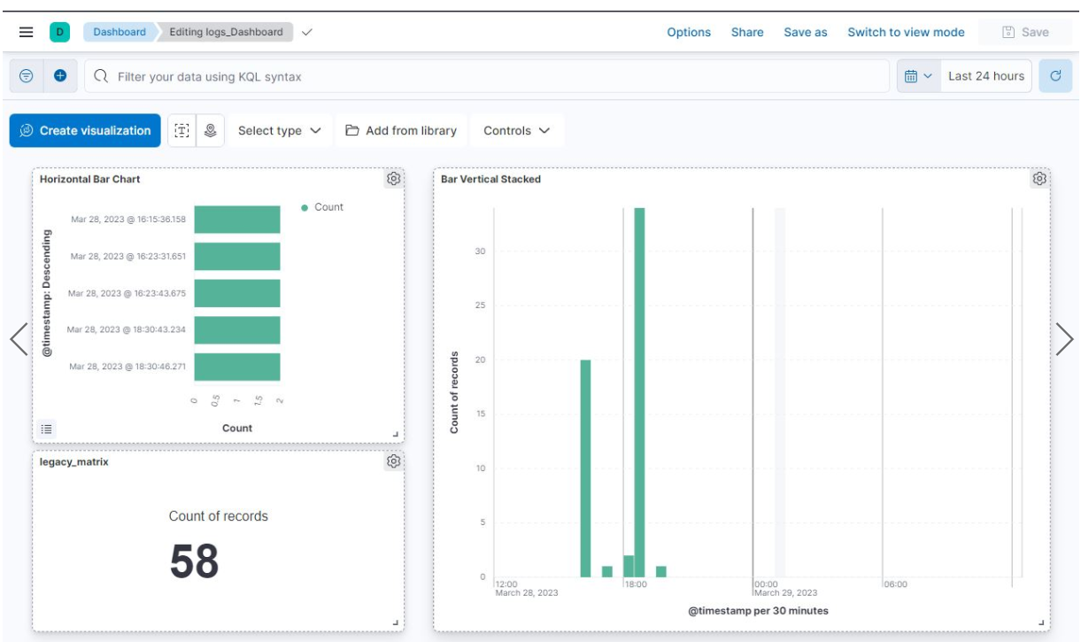
Kibana Logs

Slide 39
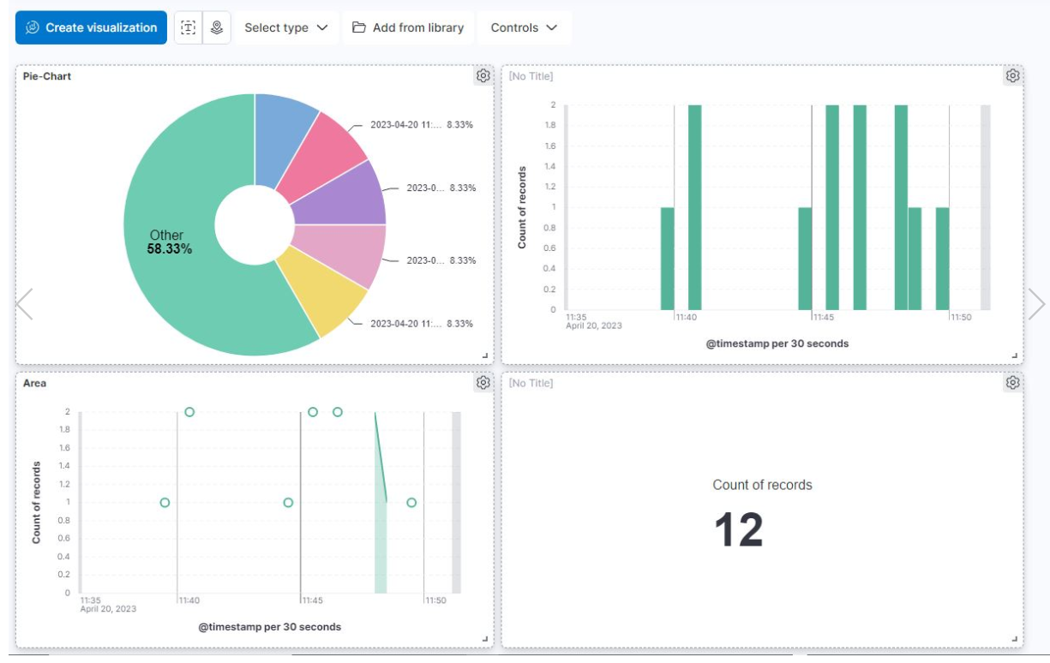

Slide 40
V. Future Enhancement for Database Migration
Make Ui for migrating user data as per company name
Make Migration GDPR Compatible.

Slide 41

Any Questions

Slide 42
Thank You!

